Slide 1
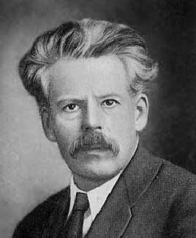
Chapter Seven
Slutsky Equation
Slutsky 方程

Slide 2
Effects of a Price Change
What happens when a commodity’s price decreases?
  Substitution effect (替代效应）: the commodity is relatively cheaper, so consumers substitute it for now relatively more expensive other commodities.

Slide 3
Effects of a Price Change
  Income effect （收入效应）: the consumer’s budget of $y can purchase more than before, as if the consumer’s income rose, with consequent income effects on quantities demanded.

Slide 4

Effects of a Price Change
Consumer’s budget is $y.
x₂
Original choice
x₁

Slide 5
Effects of a Price Change
Consumer’s budget is $y.
x₂
Lower price for commodity 1
pivots the constraint outwards.
x₁

Slide 6

Effects of a Price Change
Consumer’s budget is $y.
x₂
Lower price for commodity 1
pivots the constraint outwards.
Now only $y’ are needed to buy the
original bundle at the new prices,
as if the consumer’s income has
increased by $y - $y’.
x₁

Slide 7
Effects of a Price Change
Changes to quantities demanded due to this ‘extra’ income are the income effect of the price change.

Slide 8
Slutsky Equation
Slutsky discovered that changes to demand from a price change are always the sum of a pure substitution effect and an income effect.

Slide 9
Real Income Changes
Slutsky asserted that if, at the new prices,
  less income is needed to buy the original bundle then “real income” is increased
  more income is needed to buy the original bundle then “real income” is decreased

Slide 10
Real Income Changes
x₂
Original budget constraint and choice
x₁

Slide 11
Real Income Changes
x₂
Original budget constraint and choice
New budget constraint
x₁

Slide 12
Real Income Changes
x₂
Original budget constraint and choice
New budget constraint; real
income has risen
x₁

Slide 13
Real Income Changes
x₂
Original budget constraint and choice
x₁

Slide 14
Real Income Changes
x₂
Original budget constraint and choice
New budget constraint
x₁

Slide 15
Real Income Changes
x₂
Original budget constraint and choice
New budget constraint; real
income has fallen
x₁

Slide 16
Pure Substitution Effect
Slutsky isolated the change in demand due only to the change in relative prices by asking “What is the change in demand when the consumer’s income is adjusted so that, at the new prices, she can only just buy the original bundle?”

Slide 17
Pure Substitution Effect Only
x₂
x₂’
x₁’
x₁

Slide 18
Pure Substitution Effect Only
x₂
x₂’
x₁’
x₁

Slide 19
Pure Substitution Effect Only
x₂
x₂’
x₁’
x₁

Slide 20
Pure Substitution Effect Only
x₂
x₂’
x₂’’
x₁’
x₁’’
x₁

Slide 21
Pure Substitution Effect Only
x₂
Lower p₁ makes good 1 relatively
cheaper and causes a substitution
from good 2 to good 1.
(x₁’,x₂’) → (x₁’’,x₂’’) is the
pure substitution effect.
x₂’
x₂’’
x₁’
x₁’’
x₁

Slide 22
And Now The Income Effect
x₂
x₂’
(x₁’’’,x₂’’’)
x₂’’
x₁’
x₁’’
x₁

Slide 23
And Now The Income Effect
x₂
The income effect is
(x₁’’,x₂’’) → (x₁’’’,x₂’’’).
x₂’
(x₁’’’,x₂’’’)
x₂’’
x₁’
x₁’’
x₁

Slide 24
The Overall Change in Demand
x₂
The change to demand due to
lower p₁ is the sum of the
income and substitution effects,
(x₁’,x₂’) → (x₁’’’,x₂’’’).
x₂’
(x₁’’’,x₂’’’)
x₂’’
x₁’
x₁’’
x₁

Slide 25
Slutsky’s Effects for Normal Goods
Most goods are normal (i.e. demand increases with income).
The substitution and income effects change the demand of the normal good in the same direction when a normal good’s own price changes.

Slide 26
Slutsky’s Effects for Normal Goods
x₂
Good 1 is normal because
higher income increases
demand
x₂’
(x₁’’’,x₂’’’)
x₂’’
x₁’
x₁’’
x₁

Slide 27
Slutsky’s Effects for Normal Goods
x₂
Good 1 is normal because
higher income increases
demand, so the income
and substitution
effects change the
demand of the good
in the same direction
x₂’
(x₁’’’,x₂’’’)
x₂’’
x₁’
x₁’’
x₁

Slide 28
Slutsky’s Effects for Normal Goods
Since both the substitution and income effects increase demand when own-price falls, a normal good’s ordinary demand curve slopes down.
The Law of Downward-Sloping Demand therefore always applies to normal goods.

Slide 29
Slutsky’s Effects for Income-Inferior Goods
Some goods are income-inferior (i.e. demand is reduced by higher income).
The substitution and income effects oppose each other when an income-inferior good’s own price changes.

Slide 30
Slutsky’s Effects for Income-Inferior Goods
x₂
x₂’
x₁’
x₁

Slide 31
Slutsky’s Effects for Income-Inferior Goods
x₂
x₂’
x₂’’
x₁’
x₁’’
x₁

Slide 32
Slutsky’s Effects for Income-Inferior Goods
x₂
The pure substitution effect is as for
a normal good. But, ….
x₂’
x₂’’
x₁’
x₁’’
x₁

Slide 33
Slutsky’s Effects for Income-Inferior Goods
x₂
The pure substitution effect is as for a normal good. But, the income effect is
in the opposite direction.
(x₁’’’,x₂’’’)
x₂’
x₂’’
x₁’
x₁’’
x₁

Slide 34
Slutsky’s Effects for Income-Inferior Goods
x₂
The pure substitution effect is as for a normal good. But, the income effect is
in the opposite direction. Good 1 is
income-inferior
because an
increase to income
causes demand to
fall.
(x₁’’’,x₂’’’)
x₂’
x₂’’
x₁’
x₁’’
x₁

Slide 35
Slutsky’s Effects for Income-Inferior Goods
x₂
The overall changes to demand are
the sums of the substitution and
income effects.
(x₁’’’,x₂’’’)
x₂’
x₂’’
x₁’
x₁’’
x₁

Slide 36
Giffen Goods
In rare cases of extreme income-inferiority, the income effect may be larger in size than the substitution effect, causing quantity demanded to fall as own-price rises.
Such goods are Giffen goods.

Slide 37
Slutsky’s Effects for Giffen Goods
x₂
A decrease in p₁ causes
quantity demanded of
good 1 to fall.
x₂’
x₁’
x₁

Slide 38
Slutsky’s Effects for Giffen Goods
x₂
A decrease in p₁ causes
quantity demanded of
good 1 to fall.
x₂’’’
x₂’
x₁’’’
x₁’
x₁

Slide 39
Slutsky’s Effects for Giffen Goods
x₂
A decrease in p₁ causes
quantity demanded of
good 1 to fall.
x₂’’’
x₂’
x₂’’
x₁’’’
x₁’
x₁’’
x₁
Substitution effect
Income effect

Slide 40
Slutsky’s Effects for Giffen Goods
Slutsky’s decomposition of the effect of a price change into a pure substitution effect and an income effect thus explains why the Law of Downward-Sloping Demand is violated for extremely income-inferior goods.

Slide 41
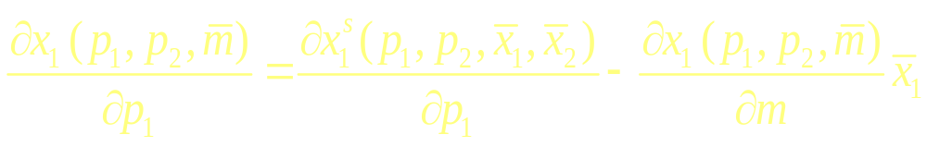
The Slutsky Equation
(-)
(?)
(-)
(+) if normal
(-) if inferior

Slide 42
Remaining Topics
Examples of decomposition
  Perfect complements preferences
  Perfect substitute preferences
  Quasi-linear preferences
Hicksian substitution effect

Slide 43
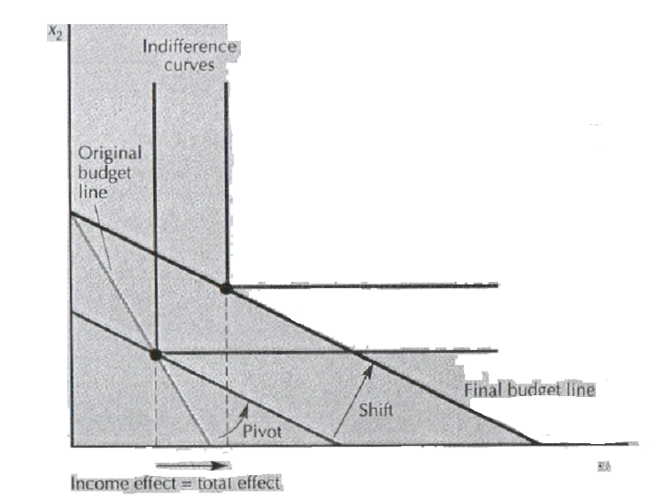

Slide 44
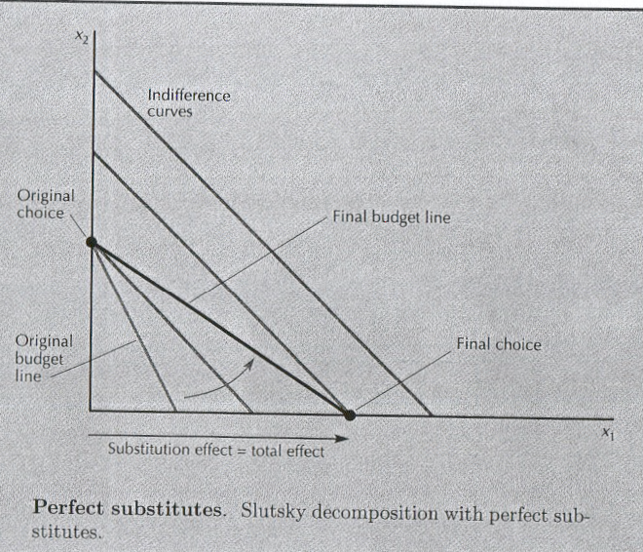

Slide 45
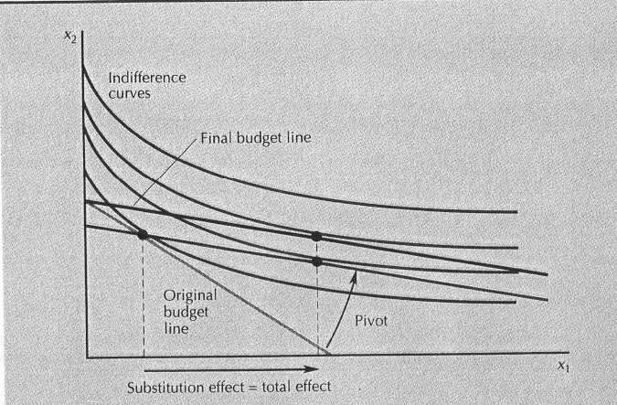
Quasi-linear preferences
因为每条线都平行，所以收入两条线必交于同一点

Slide 46
